Slide 1
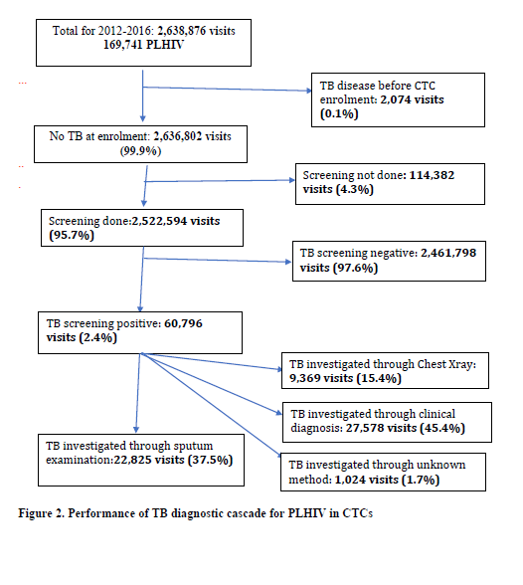
What is the performance of Tuberculosis management among People Living with HIV in HIV care and treatment settings in Tanzania?
Werner Maokola1, Prosper Faustine1, Bonaventura Mpondo1, Renatus Kisendi1, Sia Msuya2, Jim Todd2,3 and Beatrice Mutayoba1
1Ministry of Health, Community Development, Gender, Elderly and Children, National AIDS Control Program, Dodoma, Tanzania, United Republic of, 2Kilimanjaro Christian Medical University College, Institute of Public Health, Moshi, Tanzania, United Republic of, 3London School of Hygiene and Tropical Medicine, London, United Kingdom
Background:
Comprehensive HIV care and treatment services entail routine screening for Tuberculosis (TB) symptoms and signs during every visit to HIV care and treatment clinic (CTC). Individuals with positive screening are further evaluated for TB disease whereas those who screen negative are evaluated for TB preventive therapy. The TB management cascade among People Living with HIV (PLHIV) needs to be evaluated for quality improvement.
Methods:
We evaluated how well the protocol for TB screening was carried out over 5 years period. We also investigated the quality of the confirmation tests in those PLHIV who were positive on the screening test.
.
Results:
The cohort had 169,741 PLHIV who made 2,638,876 visits to CTC over the five years. We excluded 2,074 (0.80%) visits as these involved PLHIV enrolled in CTC with a prior TB disease diagnosis, and who received treatment for TB.
Of the 2,636,802 visits, 2,524,494 (95.67%) had TB screening according to the national HIV guidelines, of which 88,028 (3.49%) had TB screening positive results.
Of the 88,028 visits with a positive TB screening, 10,496(11.92%) were further investigated using x-rays, 48,930(55.58%) through sputum smears, 792(0.90%) through clinical investigation alone and 27,810(31.59%) had no further TB diagnosis within 2 weeks after positive TB screening.
Of all visits with positive TB screening, 32,986 (37.50%) had TB disease diagnosis.
Conclusion:
There was a high TB screening among CTC attendees, however, one third of the visits with positive screening missed evidence for further TB diagnosis evaluation. There is therefore need to scale up and or consolidate tracking along TB management cascade in HIC clinic settings.
TB screening questions asked in visits to CTC:
Cough of any duration
Fever of any duration
Weight loss
Night sweats
References:
Maokola et.al.
Mollel et al.
Acknowledgements: Ministry of Health Tanzania and Bill and Melinda Gates Foundation
PRESENTED AT THE 23RD INTERNATIONAL AIDS CONFERENCE (AIDS 2020) | 6-10 JULY 2020

